Slide 1
FLORAL
NONPROFIT MARKETING PLAN
Here is where your presentation begins

Slide 2
CONTENTS OF THIS TEMPLATE
Here’s what you’ll find in this Slidesgo template:
A slide structure based on a portfolio, which you can easily adapt to your needs. For more info on how to edit the template, please visit Slidesgo School or read our FAQs.
An assortment of illustrations that are suitable for use in the presentation can be found in the alternative resources slide.
A contact slide, which you must keep so that proper credits for our design are given.
A resources slide, where you’ll find links to all the elements used in the template.
Instructions for use.
Final slides with:
The fonts and colors used in the template.
A selection of illustrations. You can also customize and animate them as you wish with the online editor. Visit Stories by Freepik to find more.
More infographic resources, whose size and color can be edited.
Sets of customizable icons of the following themes: general, business, avatar, creative process, education, help & support, medical, nature, performing arts, SEO & marketing, and teamwork.
You can delete this slide when you’re done editing the presentation

Slide 3
TABLE OF CONTENTS
01
02
03
04
05
06
ABOUT US
MARKET
GOALS
Here you could describe the topic of the section
Here you could describe the topic of the section
Here you could describe the topic of the section
ANALYSIS
BUDGET
CONTENT PLAN
Here you could describe the topic of the section
Here you could describe the topic of the section
Here you could describe the topic of the section

Slide 4
01
A NEW SECTION
It could be the part of the presentation where you can introduce yourself, write your email…

Slide 5
“This is a quote. Words full of wisdom that someone important said and can make the reader get inspired.”
—SOMEONE FAMOUS

Slide 6
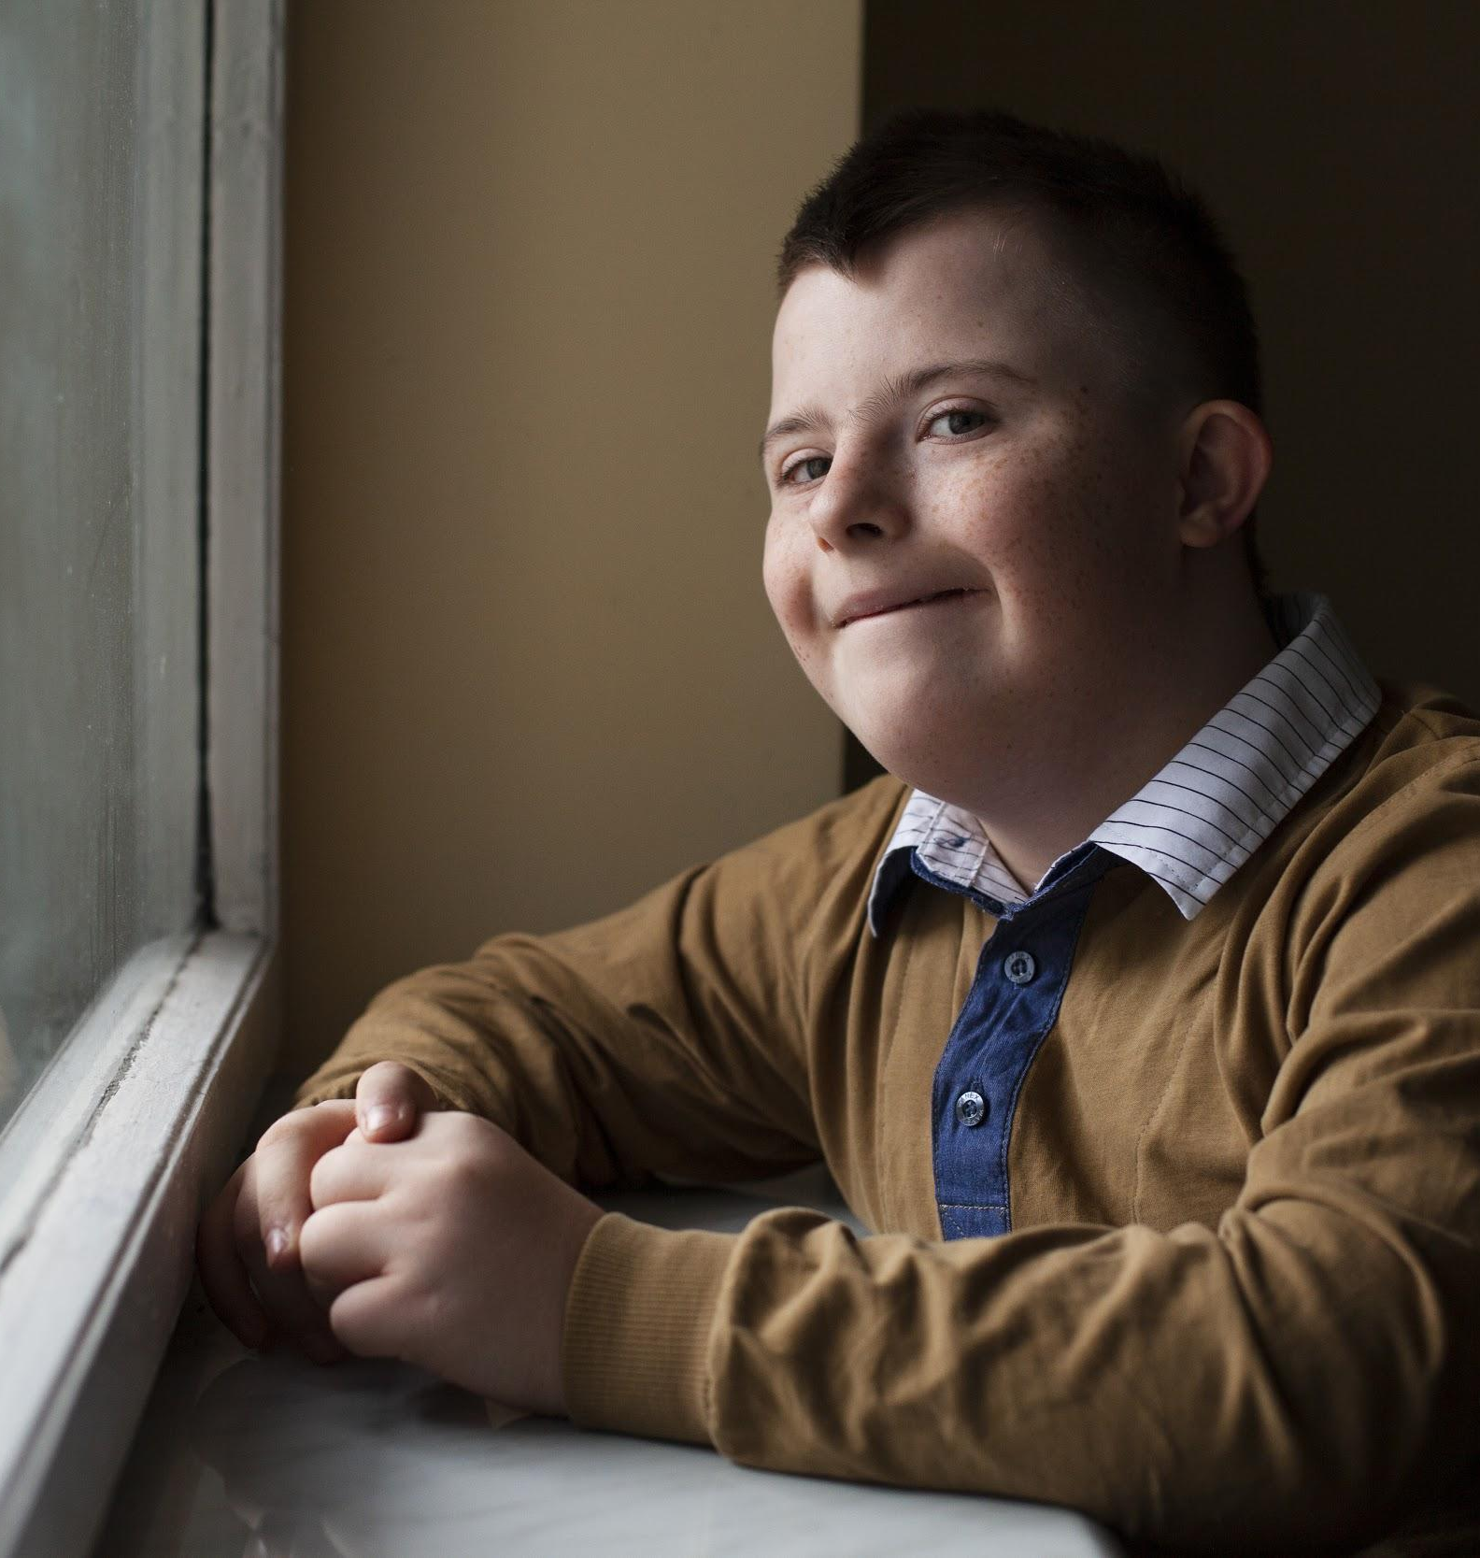
OUR COMPANY
Mercury is the closest planet to the Sun and the smallest one in the Solar System—it’s only a bit larger than our Moon.

Slide 7
OUR EVOLUTION
2005
2010
Mercury is the closest planet to the Sun
Mercury is the closest planet to the Sun
1
2
3
t’s the biggest planet in our Solar System
2008

Slide 8
2012
Jupiter is the biggest planet in our Solar System
4
5
Neptune is the farthest planet from the Sun
2012

Slide 9

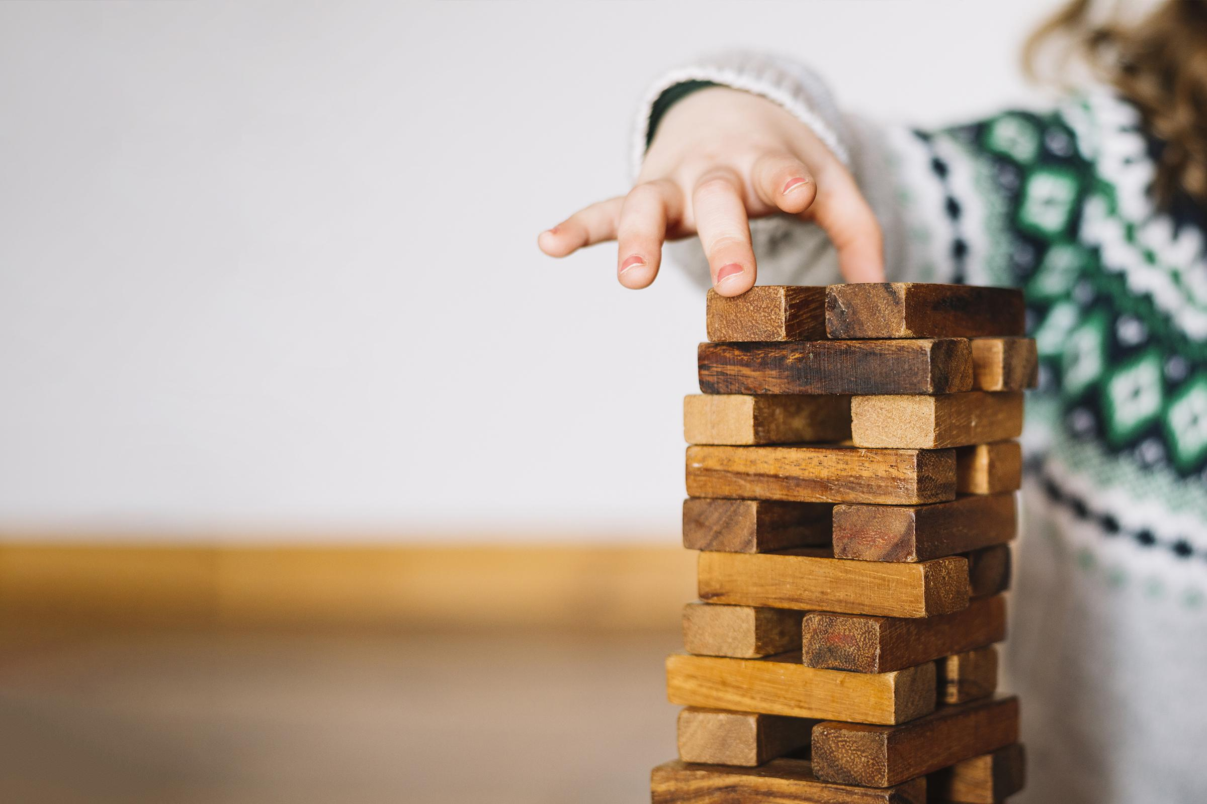
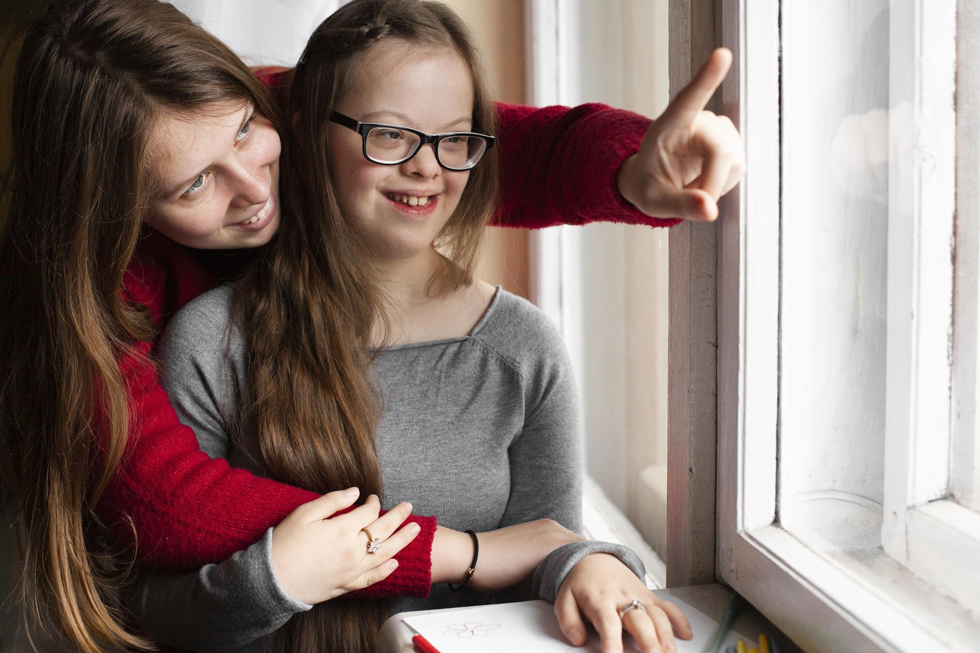
WHAT SETS US APART?
NEPTUNE
SATURN
MARS
Mercury is the closest planet to the Sun and also the smallest one
It’s the farthest planet from the Sun and the fourth-largest in our System
Despite being red, Mars is a cold place, not hot. It’s full of iron oxide dust

Slide 10
GUIDING PRINCIPLES
VENUS
MARS
JUPITER
Venus has a beautiful name, but it’s hot
Despite being red, Mars is a cold place, not hot
It’s a gas giant and the biggest planet
MERCURY
NEPTUNE
Mercury is the closest planet to the Sun
Neptune is the farthest planet from the Sun

Slide 11
REVIEWING CONCEPTS IS A GOOD IDEA
MERCURY
VENUS
MARS
Mercury is the closest planet to the Sun
Venus has a beautiful name, but it’s terribly hot
Despite being red, Mars is a cold place, not hot
JUPITER
SATURN
NEPTUNE
It’s the biggest planet in our Solar System
Saturn is the ringed one and a gas giant
Neptune is the farthest planet from the Sun

Slide 12
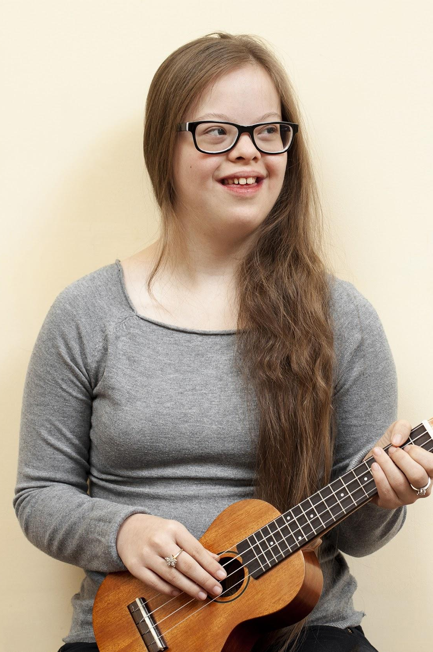
MARKET SHARE
VENUS
MARS
Venus has a beautiful name, but it’s terribly hot, even hotter than Mercury
Despite being red, Mars is a cold place, not hot. It’s full of iron oxide dust
MERCURY
SATURN
Mercury is the closest planet to the Sun and is only a bit larger than our Moon
Yes, this is the ringed one. It’s a gas giant, composed of hydrogen and helium

Slide 13
BUYER PERSONA PROFILE
WANTS PRIVACY
INTERETS
Blocks ads
Has plants
Doesn’t share location
Climate change
SHOPPING CHOICES
LIKELY PROFILES
Mercury
Venus
Neptune

Slide 14
4,498,300,000
Big numbers catch your audience’s attention

Slide 15
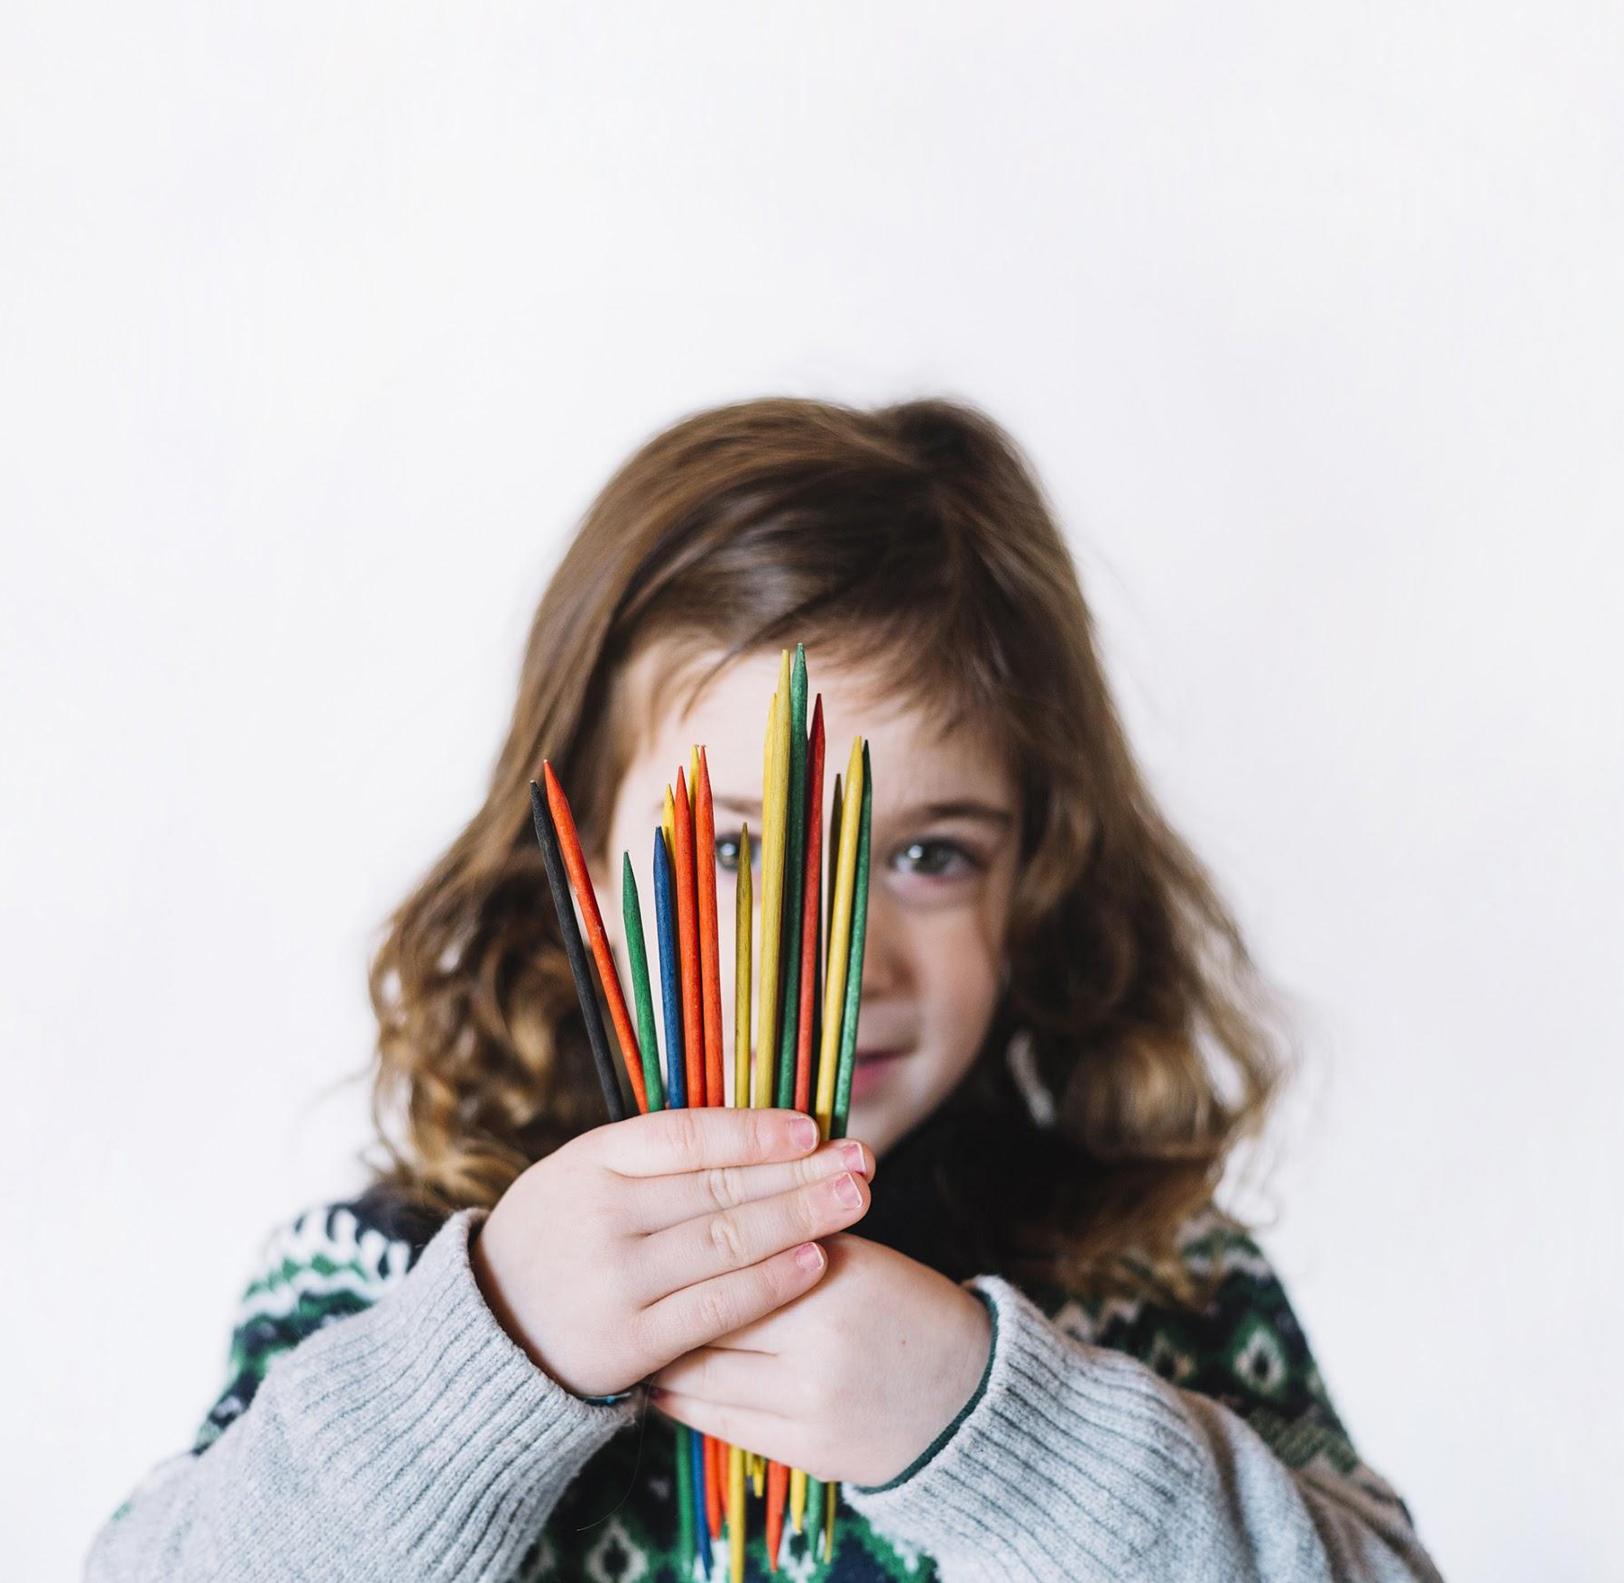
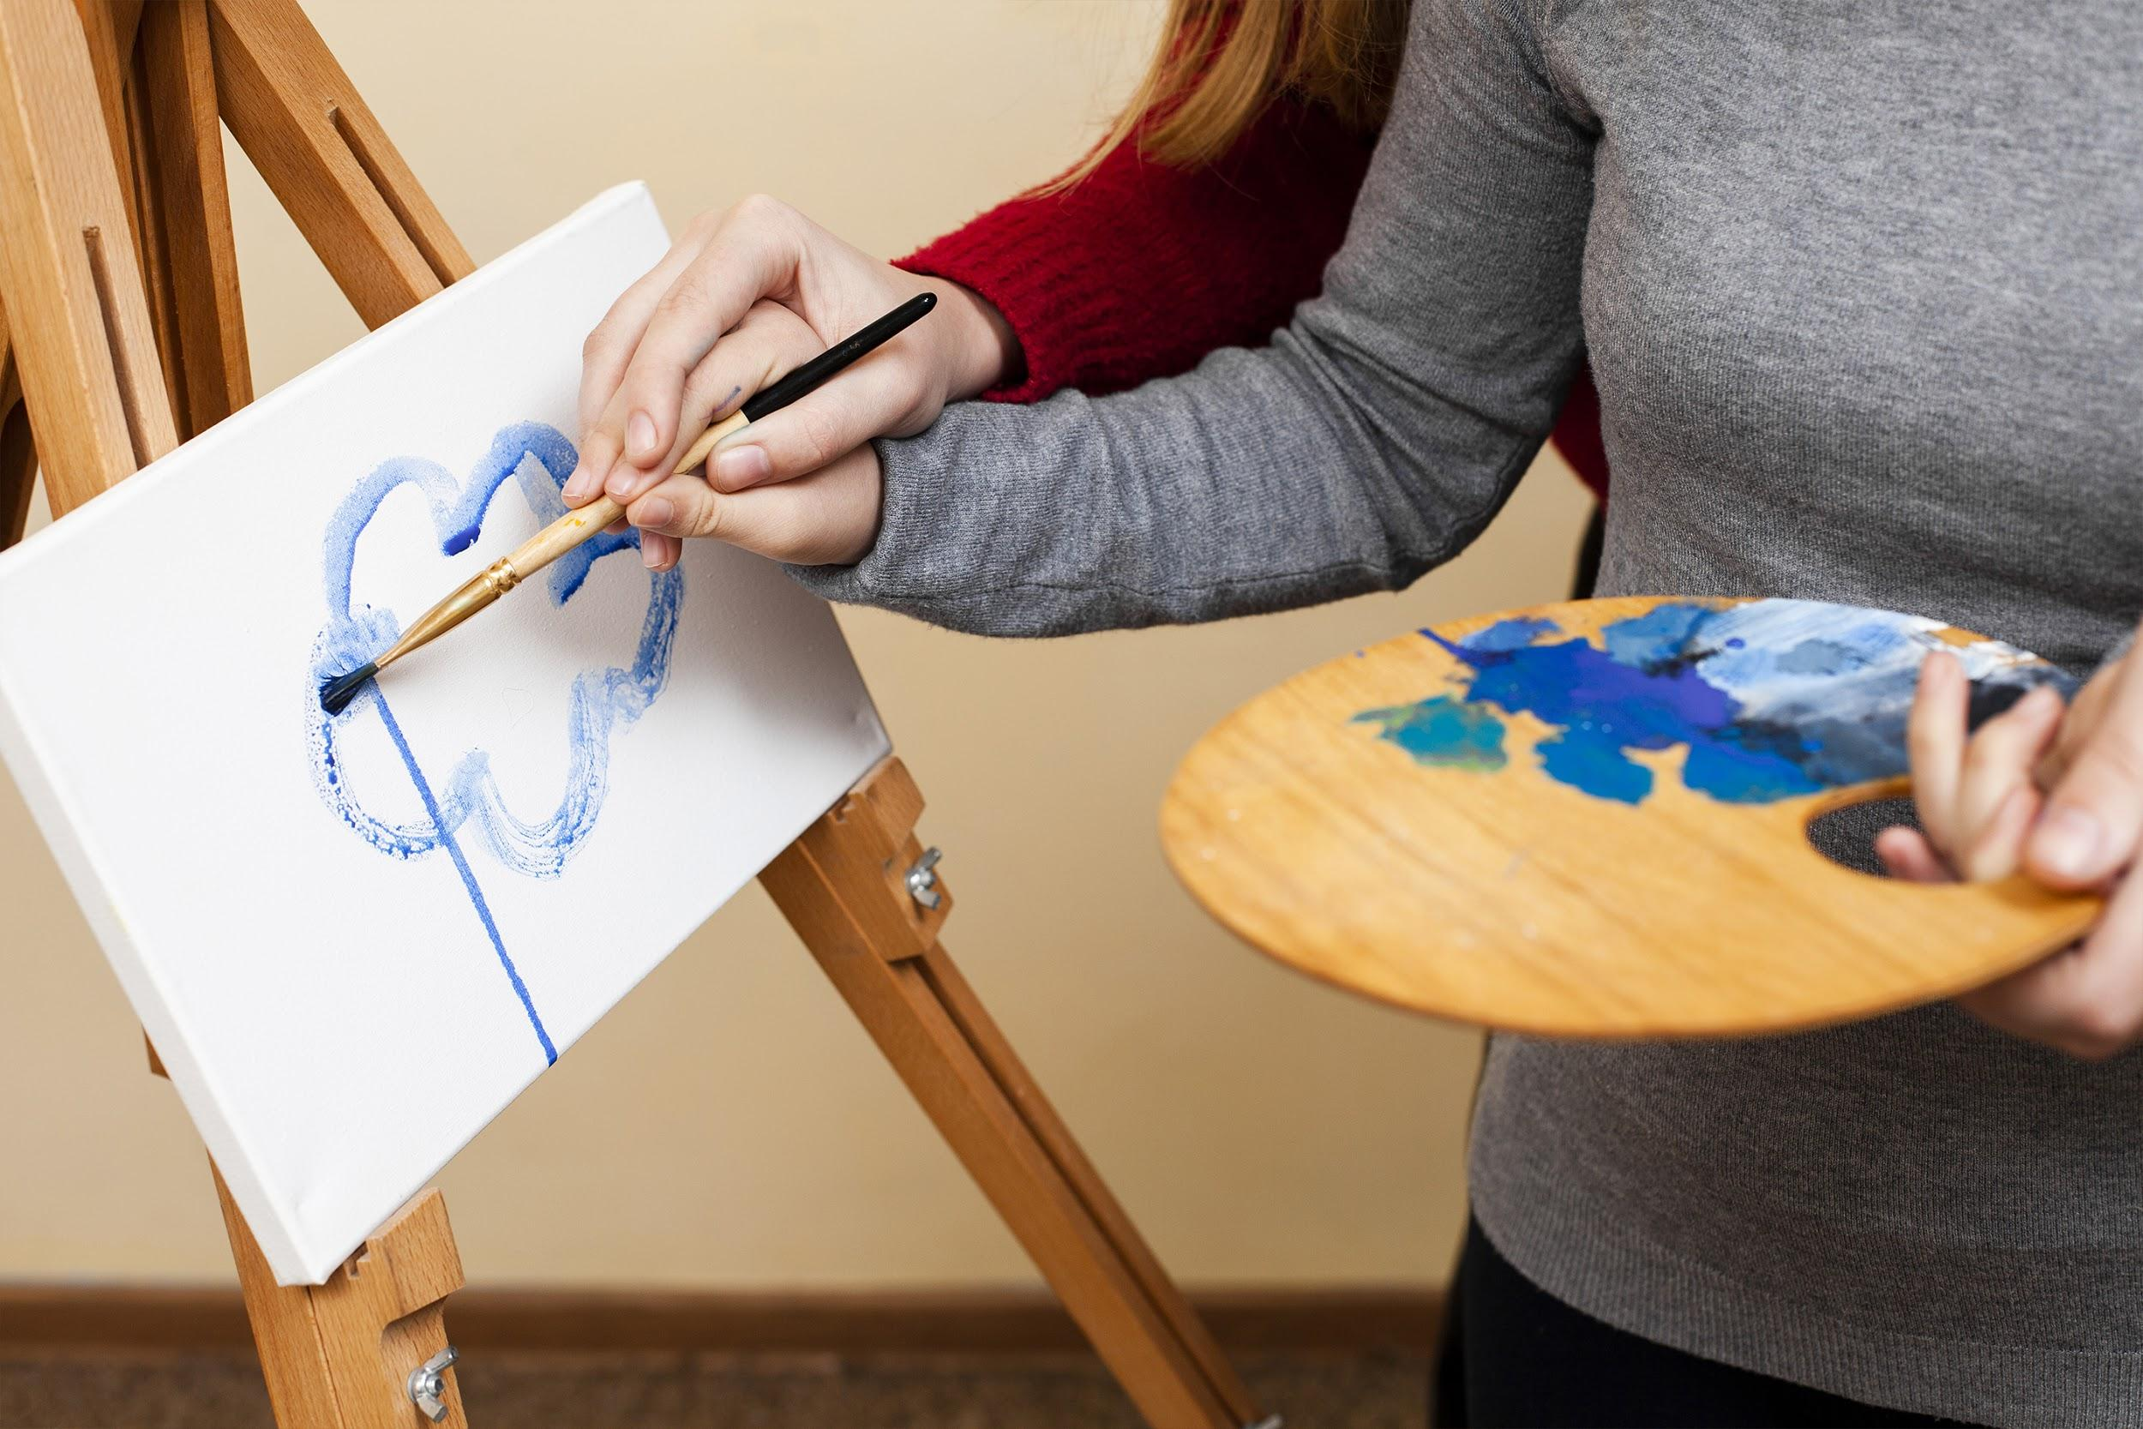
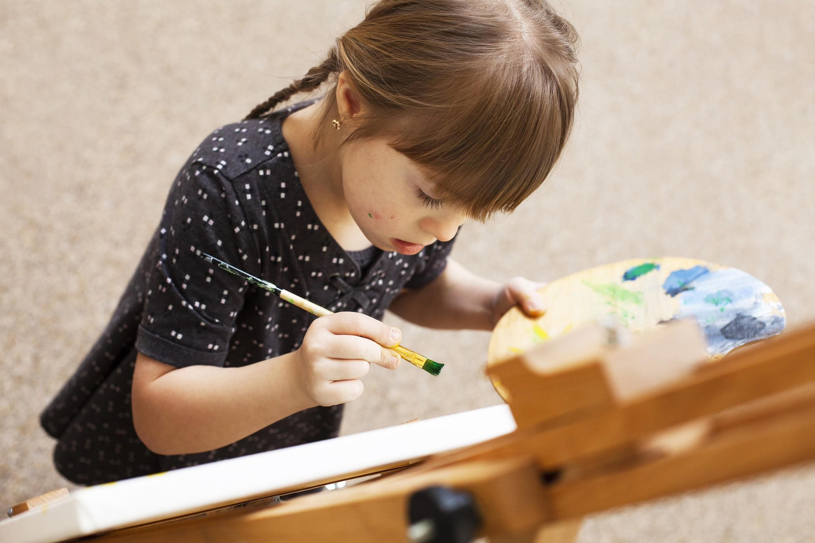
BUYER JOURNEY
AWARENESS
CONSIDERATION
DECISION
Venus has a beautiful name and is the second planet from the Sun
Mercury is the closest planet to the Sun and the smallest one in the System
Jupiter is a gas giant and the biggest planet in our Solar System

Slide 16
SALES FUNNEL
INTEREST
AWARENESS
Jupiter is a gas giant and the biggest one
Venus has a beautiful name is the second
PURCHASE
DECISION
Despite being red, Mars is a cold place
Saturn is composed mostly of hydrogen

Slide 17
COMPETITOR ANALYSIS
25%
50%
20%
18%
MERCURY
MARS
NEPTUNE
JUPITER
Neptune is the farthest planet from the Sun
Mercury is the closest planet to the Sun
Despite being red, Mars is a cold place, not hot
It’s a gas giant and the biggest planet in our Solar System

Slide 18
SWOT ANALYSIS
STRENGTHS
WEAKNESSES
Jupiter is a gas giant and the biggest planet in our Solar System
Despite being red, Mars is a cold place, not hot. It’s full of iron oxide dust
OPPORTUNITIES
THREATS
Venus has a beautiful name and is the second planet from the Sun
Saturn is a gas giant, composed mostly of hydrogen and helium

Slide 19

GOALS
GOAL 1
GOAL 2
Jupiter is the biggest planet in our System
Despite being red, Mars is a cold place, not hot
GOAL 3
GOAL 4
Saturn is mostly composed of hydrogen
Mercury is the closest planet to the Sun

Slide 20
STRATEGY
1
MERCURY
Mercury is the closest planet to the Sun
KEY ACTION 1
2
JUPITER
It’s a gas giant and the biggest planet
Neptune is the fourth-largest planet
GOAL
The Sun is the star at the center of the Solar System
3
SATURN
KEY ACTION 2
Despite being red, Mars is a cold place
Venus has a beautiful name, but it’s terribly hot
4
MARS
It’s a gas giant, mostly composed of hydrogen

Slide 21
A PICTURE IS WORTH A
THOUSAND WORDS

Slide 22
KEY ACTION ITEMS
 | FIRST QUARTES | SECOND QUARTER | THIRD QUARTER
Key Action 1 | Here you can describe your items | Neptune is the farthest planet | It’s the biggest planet in our Solar
Key Action 2 | Composed mostly of hydrogen | Venus has a beautiful name | Here you could describe the topic
Key Action 3 | It’s full of iron oxide dust | Mercury is the closest planet to the Sun | It’s the second-brightest natural object
Key Action 4 | Saturn is the ringed one | Despite being red, Mars is actually cold | and its atmosphere is extremely poisonous

Slide 23
TIMELINE
STEP 1
STEP 3
STEP 5
Saturn is the ringed one. It’s a gas giant
Venus has a beautiful name but it’s hot
Jupiter is the biggest planet in our System
STEP 2
STEP 4
Mercury is the closest planet to the Sun
Despite being red, Mars is a cold place

Slide 24
BUDGET
20,000,000
35%
15%
20%
20%
20%
QUARTERLY BUDGET
MERCURY
NEPTUNE
SUN
VENUS
JUPITER
MARS

Slide 25
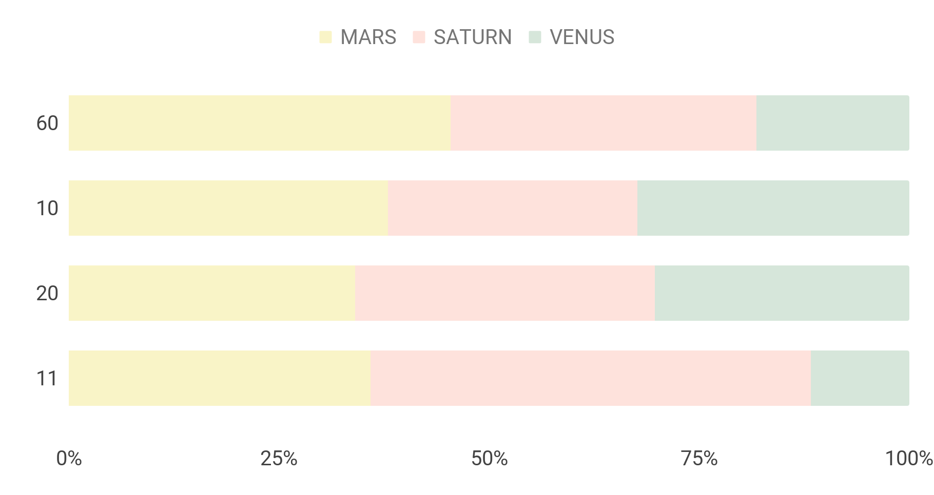
Kpi overview
OUTREACH
COMPLIANCE RATE
Mercury is the closest planet
Despite being red, Mars is cold
If you want to modify this graph, click on it, follow the link, change the data and replace it

Slide 26
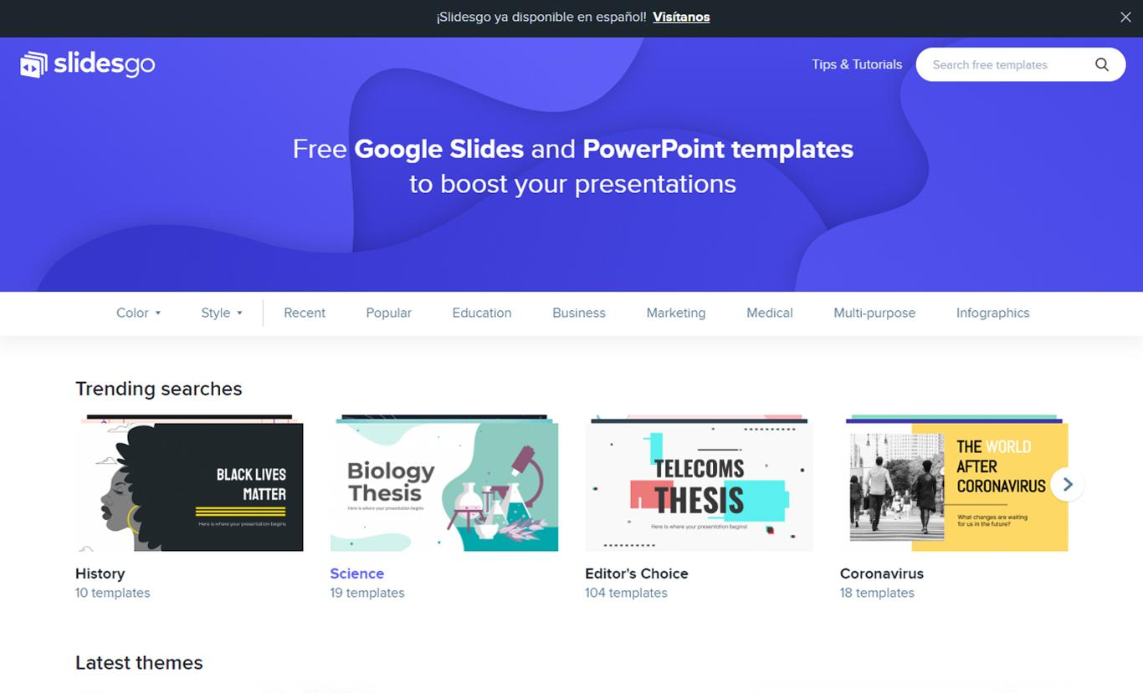
DESKTOP SOFTWARE
You can replace the image on the screen with your own work. Just delete this one, add yours and send it to the back

Slide 27
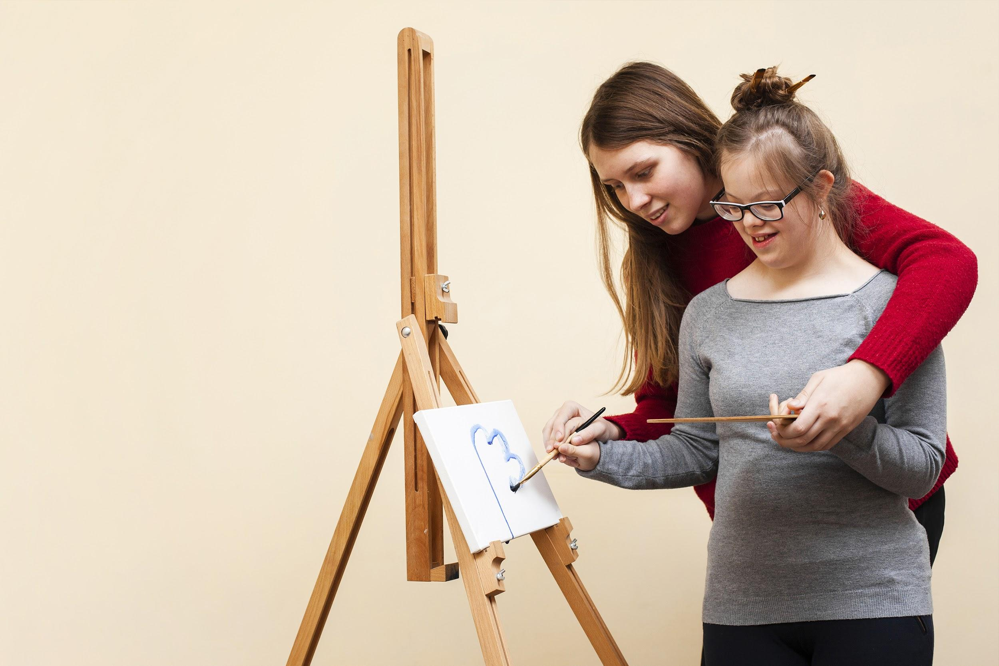

OUR TEAM
HELENA JAMES
JANE DOE
You can replace the image on the screen with your own
You can replace the image on the screen with your own

Slide 28
THANKS
Does anyone have any questions?
addyouremail@freepik.com +91 620 421 838
yourcompany.com
Please keep this slide for attribution

Slide 29
RESOURCES
PHOTOS
Woman helping smiling girl with down syndrome painting
Pintura de alto ángulo de niña con síndrome de down
Woman helping girl with down syndrome painting
Happy girl with down syndrome with guitar
Boy with down syndrome posing by the window
Woman pointing at window at girl with down syndrome
Portrait of a girl holding multi colored plastic sticks
cute girl playing tower
Woman drawing with girl with down syndrome

Slide 30
RESOURCES
VECTORS
Hand drawn abstract organic shapes background
Vector handwritten boho logos

Slide 31
ALTERNATIVE RESOURCES
PHOTOS
Happy girl with down syndrome and copy space
Smiling girl with down syndrome and woman with boy
Boy with down syndrome being happy
Girl with down syndrome with boy looking at laptop
Woman and child with down syndrome posing
Girl with down syndrome posing with guitar and blackboard
Woman with smiling child with down syndrome
Woman playing with children with down syndrome
front view of girl with down syndrome playing
Women and children with down syndrome smile and wave

Slide 32
ALTERNATIVE RESOURCES
PHOTOS
Down syndrome children drawing and having fun
Woman with guitar and girl with down syndrome having fun
Side view of boy with down syndrome playing
Down syndrome children joining
Women with children with down syndrome on the computer
Happy kids with down syndrome waving and posing
Side view of girl with down syndrome with paddle
Happy girl with down syndrome posing with colorful palms
Little girl with down syndrome playing

Slide 33
ALTERNATIVE RESOURCES

